Slide 1
CPU Scheduler Policy Comparison
Mia Larkin, Brian Platas-Guiterrez, Cecil Ho, Liya Jose
Notes:
Cecil

Slide 2

CPU Schedulers
CPU schedulers schedule jobs that are given
A good scheduler takes into account:
Flexibility --> The variability of jobs
Fairness
Performance Metrics:
Turnaround Time
Response Time
Notes:
Cecil

Slide 3

FIFO Scheduler
First In First Out
Jobs that arrive first are scheduled to execute first.
Jobs execute until termination.
FIFO Queue:
Notes:
Cecil

Slide 4
SJF Scheduler
Shortest Job First
Scheduler places the job with the shortest runtime first if the jobs arrive at the same time
Job | Arrival | Job Time
1 | 0 | 25
2 | 15 | 15
3 | 15 | 10
Job 1
Job 3
Job 2
Job 2 arrives
Job 1 arrives
Job 3 arrives
Notes:
Cecil

Slide 5
Scheduler Pros and Cons
 | FIFO | SJF
Pros | Minimal context switching overhead No starvation | Minimal average turnaround time
Cons | Big job first, potentially long waiting times (convoy effect) | Long wait times for big jobs, difficulty to know future
Notes:
Cecil

Slide 6
Displaying the Scheduling of Jobs
We can use Gantt charts to display how each scheduler processes the jobs
Example:
Job 1 arrives at t = 0s and takes 5s
Job 2 arrives at t = 5s and takes 1s
Job 3 arrives at t = 7s and takes 3s
Job 1
Job 2
Job 3
t = 0
t = 5
t = 10
Notes:
Mia

Slide 7
Calculating Turnaround Time
Turnaround time is the average time that it takes to complete a job
Turnaround Time = Completion Time – Arrival Time
Example:
A job arrives at t = 0s and it takes 10s to complete
Say we don't start the job until t = 5s so then the job completes at t = 15s
Thus: Turnaround Time = 15s – 0s = 15s
Job
10s
t = 0
t = 5
t = 15
Notes:
Mia

Slide 8
Calculating Response Times
Response time is the time it takes for the job to be picked up
Response Time = First Run Time – Arrival Time
Example:
A job arrives at t = 2s and it takes 7s to complete
Say we don't start the job until t = 5s so then the job completes at t = 12s
Thus: Response Time = 5s – 2s = 3s
Job
7s
t = 0
t = 5
t = 15
Notes:
Mia

Slide 9
Tests
Tested FIFO and SJF schedulers manually using the below sample jobs
The schedulers were built on the assumptions that we know the arrival times, runtimes, and number of jobs in order to compare their results
Job ID | Arrival Time | Job Runtime
1 | 0 | 13
2 | 0 | 5
3 | 3 | 3
4 | 4 | 18
5 | 19 | 10
Notes:
Liya

Slide 10
Calculations
Job ID | Arrival Time | Job Runtime | Turnaround Time | Response Time
1 | 0 | 13 | 13 | 0
2 | 0 | 5 | 18 | 13
3 | 3 | 3 | 18 | 15
4 | 4 | 18 | 35 | 17
5 | 19 | 10 | 30 | 20
FIFO scheduling:
t = 13
t = 18
t = 21
t = 39
t = 49
Job 1
Job 2
Job 3
Job 4
Job 5
t = 0
t = 4
t = 19
t = 3
Notes:
Liya

Slide 11
Calculations
Job ID | Arrival Time | Job Runtime | Turnaround Time | Response Time
1 | 0 | 13 | 18 | 5
2 | 0 | 5 | 5 | 0
3 | 3 | 3 | 18 | 15
4 | 4 | 18 | 35 | 17
5 | 19 | 10 | 30 | 20
SJF scheduling:
t = 5
t = 18
t = 21
t = 39
t = 49
Job 2
Job 1
Job 3
Job 4
Job 5
t = 0
t = 4
t = 19
t = 3
Notes:
Liya

Slide 12
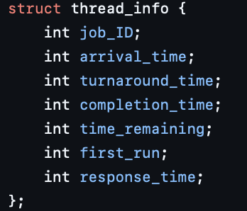
Code Breakdown Set Up
Created a structure
Assumed that time remaining of the job is known
Also assumed that the arrival time is known
Also assumed that the number of jobs was known
Notes:
Mia

Slide 13
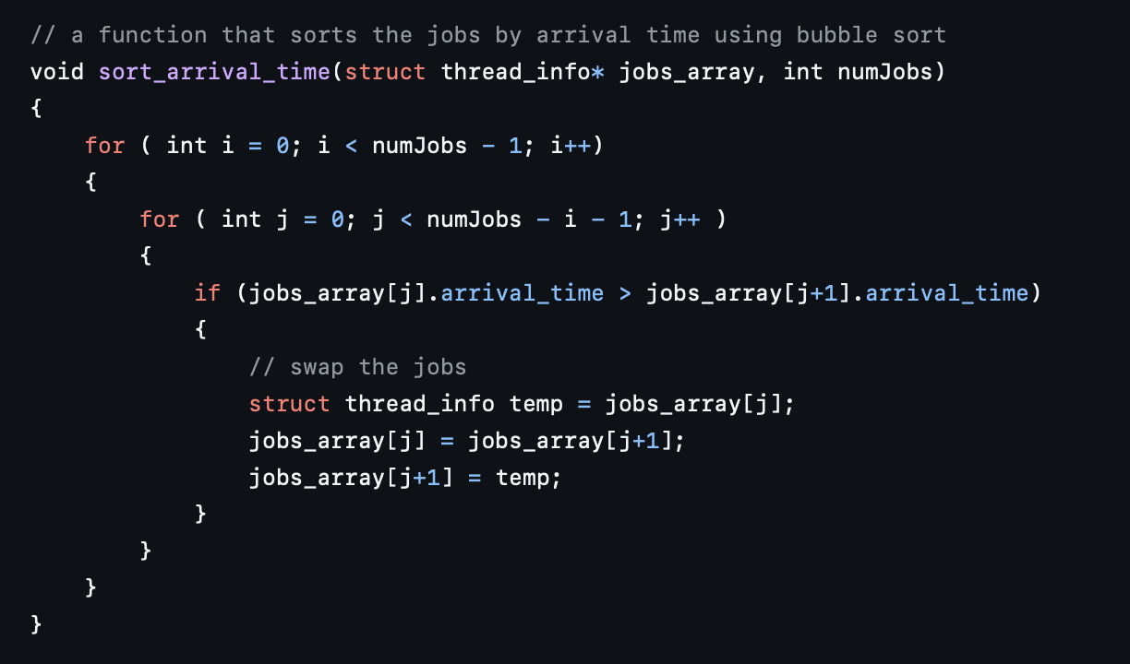
Code Breakdown - FIFO
Helper function that first sorts the jobs by their arrival time
Notes:
Mia

Slide 14
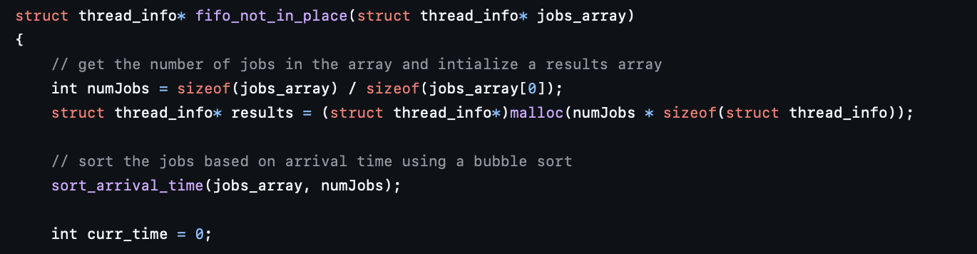
Code Breakdown - FIFO
Runs the FIFO scheduler not in place, returning a new array
Assumes that the number of jobs in known
Notes:
Mia

Slide 15
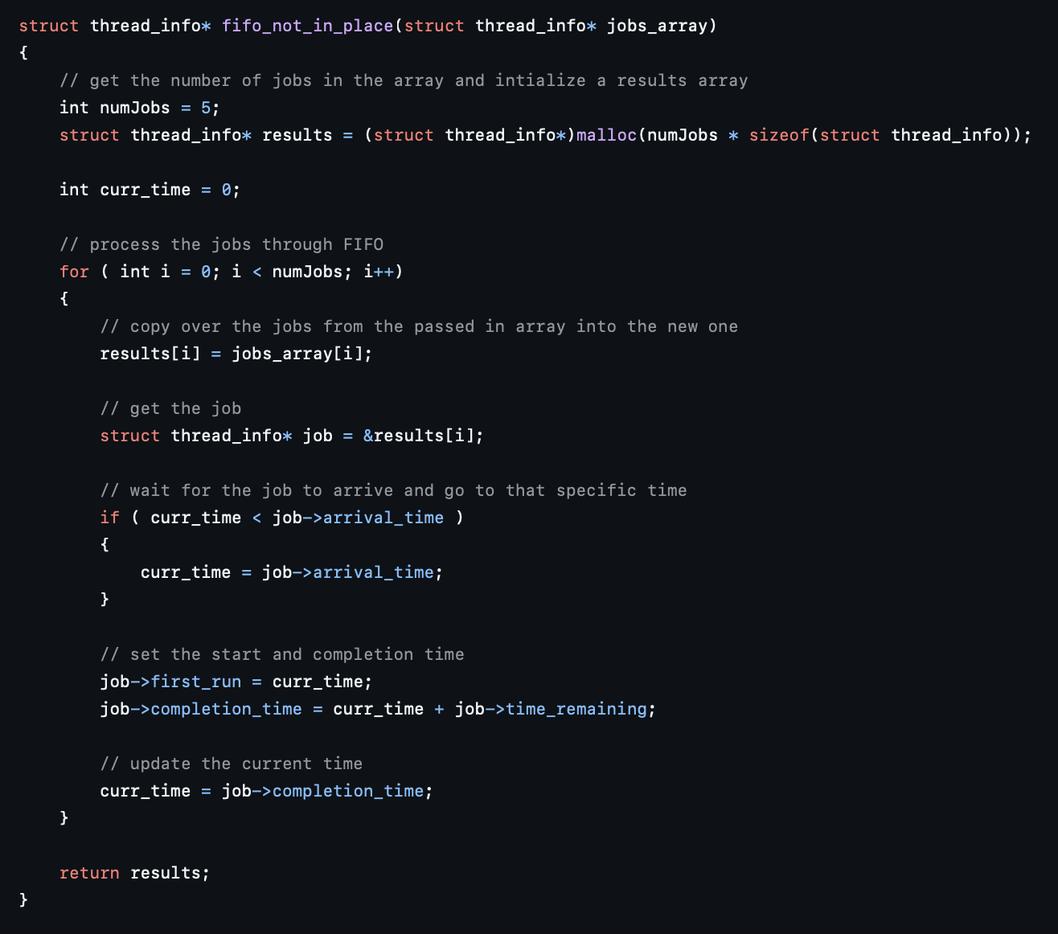
Code Breakdown - FIFO
Notes:
Mia

Slide 16
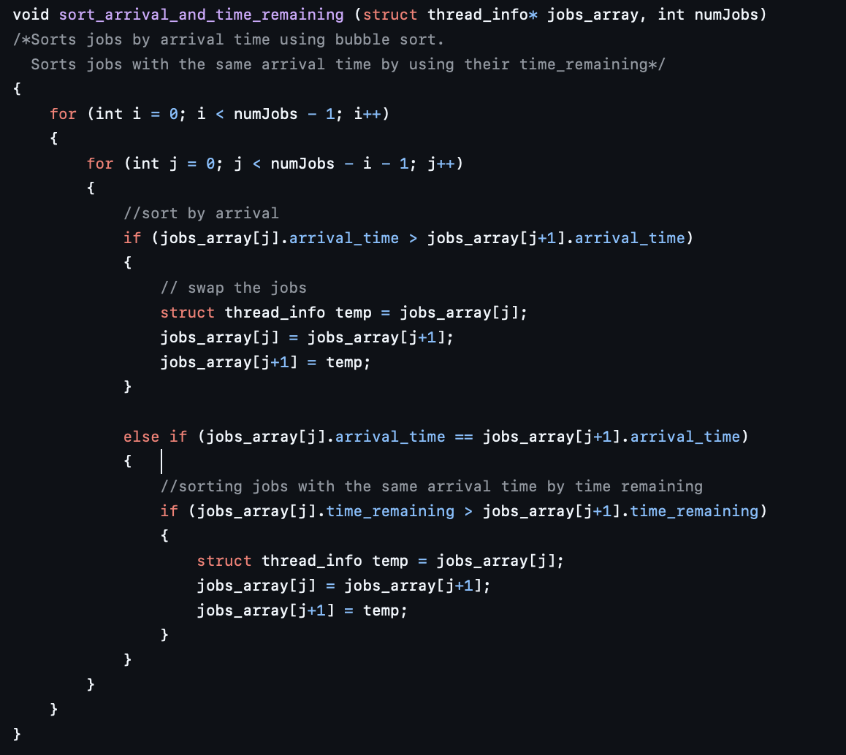
Code Breakdown - SJF
Helper function that first sorts the jobs by their arrival time
Then sorts by the time remaining if the arrival times are the same
Notes:
Brian

Slide 17
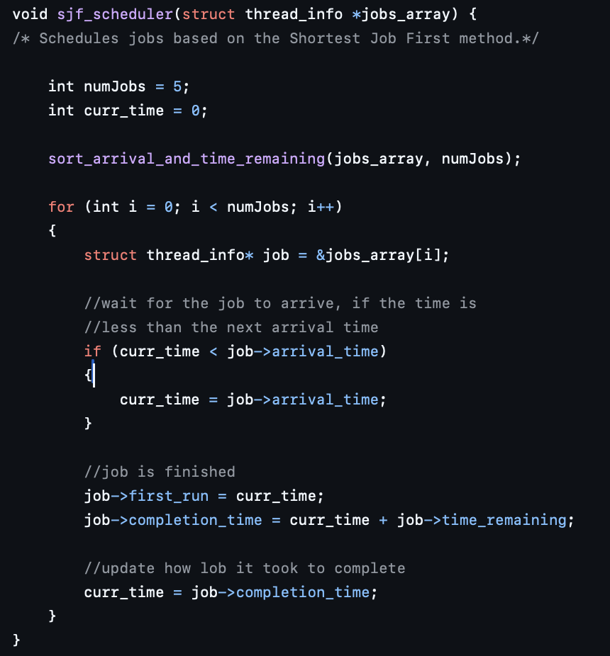
Code Breakdown - SJF
Runs the SJF scheduler in place, directly changing the struct
Assumes the number of jobs is known
Notes:
Brian

Slide 18
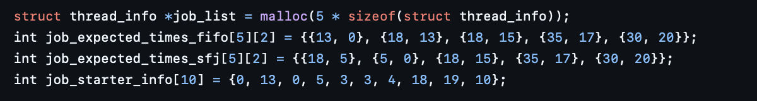
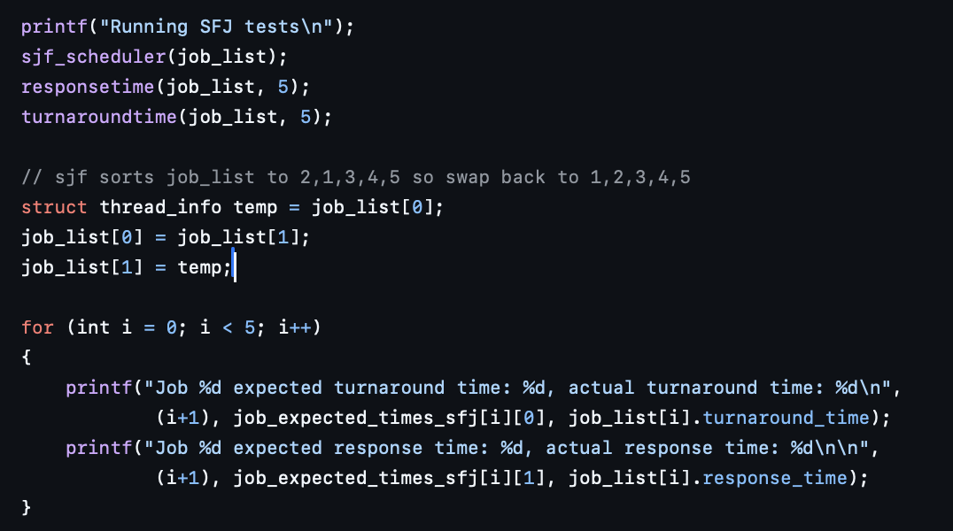
Code Breakdown – Testing
Initialize arrays of the jobs, and expected times
Runs schedulers, calculates times, and compares expected to actual
Notes:
Cecil

Slide 19
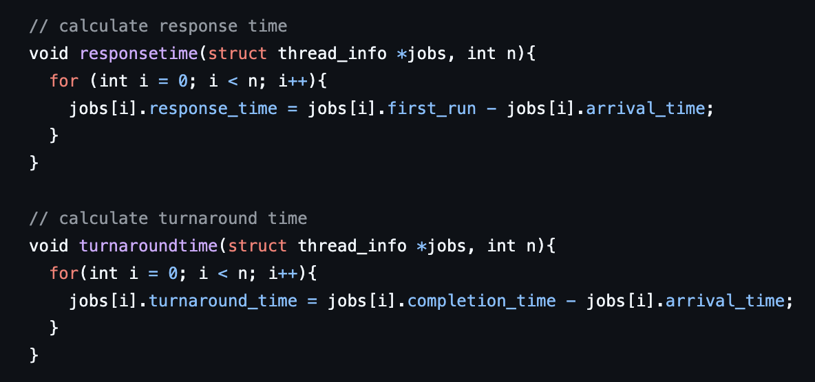
Code Breakdown - Calculations
Helper functions to calculate response time and turnaround time for each job
Notes:
Liya

Slide 20
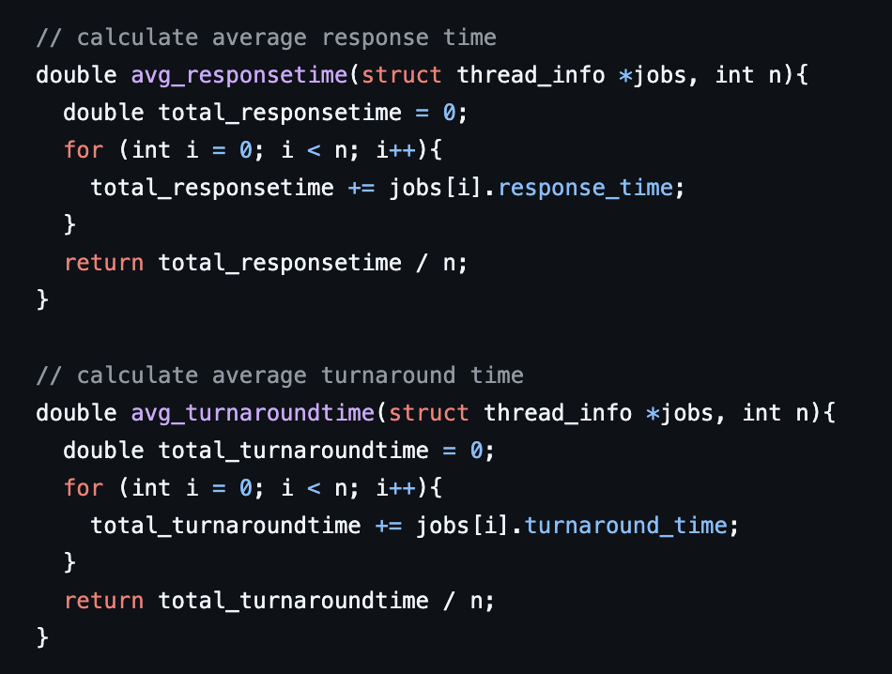
Code Breakdown - Calculations
Helper functions to calculate average response time and average turnaround time for each scheduler
Notes:
Liya

Slide 21
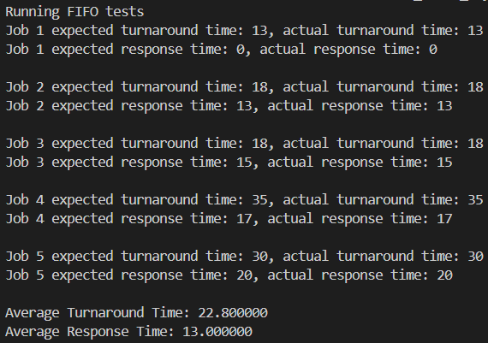
FIFO Results
Notes:
Cecil

Slide 22
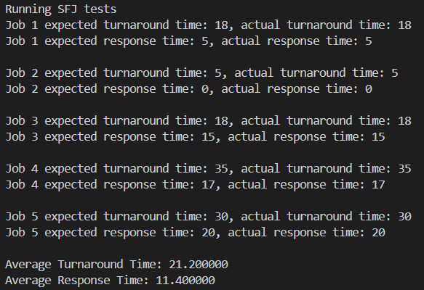
SJF Results
Notes:
Cecil

Slide 23

Optimal Scheduler
An effective scheduler would use a combination of:
Context switching and time slicing
Specializations
Prioritizing time-sensitive tasks
Optimizing I/O requests
Batching tasks that don't interact with each other to run at the same time
Implementing priority scheduling to allow important jobs to run earlier
Notes:
Brian

Slide 24
Shortest Remaining Time to Completion First (SRTCF)
When a new jobs arrives, modify the queue such that the jobs that will complete first are always being run.
A Pre-emptive scheduler: Job order can be modified to reflect changes or new information.
Job | Arrival | Job Time
1 | 0 | 26
2 | 15 | 15
3 | 15 | 10
Job 1
Job 3
Job 1
Job 2
Job 2 arrives
Job 1 arrives
Job 3 arrives
Notes:
Brian

Slide 25

Future Changes
Removing assumptions such as job runtime and number of jobs
Implement a preemptive SJF
Implement a Round-Robin scheduler
Notes:
Brian

